Slide 1
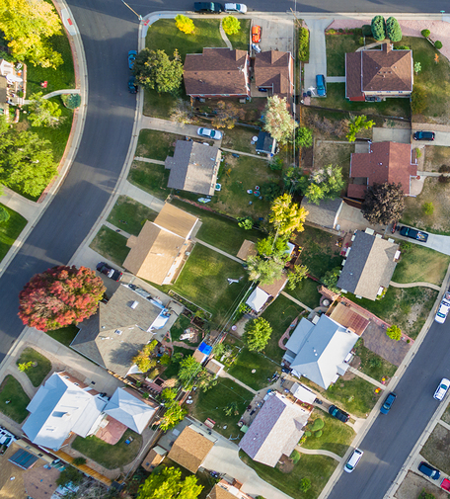
Your Properties, Managed Successfully

Slide 2
Your investments are in good hands!
We are pleased to provide you with industry leading tools that help us manage your properties. The right tools mean higher occupancy rates, quality tenants, and a more profitable investment.
Our management team is pleased provide clients with an Owner Portal, Tenant Portal, Enhanced Tenant Communication, Advanced Marketing tools and thorough Tenant Screening.

Slide 3
Connect with your properties through your Owner Portal.
The Owner Portal is one of the unique features offered by our management software, and allows us to provide you with the best and most convenient way to stay up to date on your properties’ performance.
Occupancy Rates
Lease Expirations
Future Move-Ins
Vacancy Details
Transaction History
Financial Reports
Maintenance Activity
Property Files & Documents
Transaction Attachments

Slide 4
How to Access the Owner Portal?
The Owner Portal can be accessed through this link from any computer, or via your smartphone or tablet through the Owner Connect mobile app. We’ll issue you a unique username and password when you’re ready.
Download Owner Connect for Android
Download Owner Connect for Apple

Slide 5
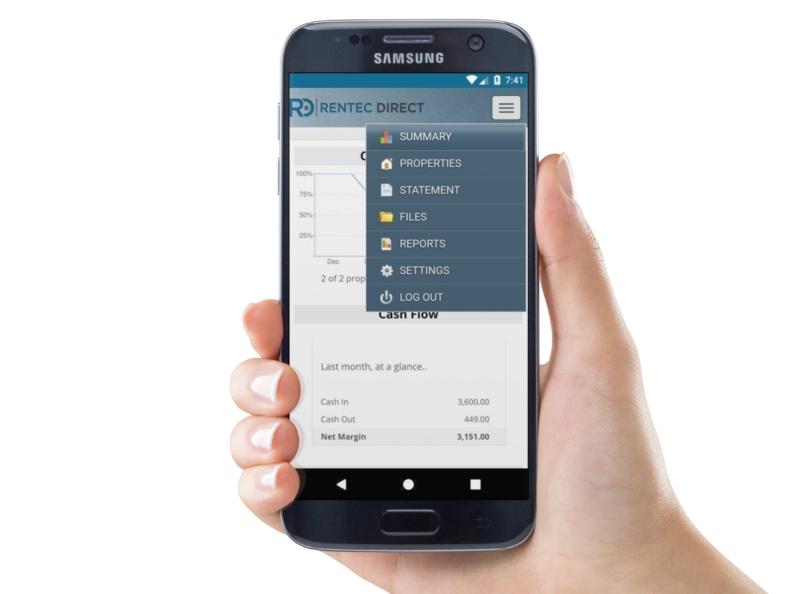


Owner Connect by Rentec Direct
available in the Apple App Store and Google Play Store

Slide 6
Your Properties With Qualified Tenants
Through our management software, we offer online marketing of your rental, reaching the widest audience possible in a matter of minutes. Our electronic rental application allows applicants easy access for applying to rent.
Once we receive a rental application, we are able to pull instant detailed background reports on the applicants who desire renting your home, assuring you the most qualified tenants.

Slide 7
Your Tenants Are Managed Professionally
We strive to manage your Tenants efficiently by utilizing the best in property management communication tools.
Automated emails notify tenants of new rent charges, remind them of delinquencies and update tenants on completed maintenance requests. Additionally, the Tenant Portal provides your tenants a mobile means to easily access to their accounting details, submit maintenance requests, purchase Renter’s Insurance and pay their rent electronically.

Slide 8
Your monthly proceeds delivered electronically
We offer electronic rent payment options for your tenants and in turn, your monthly proceeds can be sent via ACH (automatic bank transfer) and will automatically show up in your bank account. That means no checks in the mail or waiting in bank lines to make a deposit!
Setup is hassle-free! Simply provide us your routing & account numbers and we’ll take care of the rest.

Slide 9
Our Management Software
We chose the best in Property Management Software to service your rental properties based on:
System Security
Robust Features
Ease-Of-Use
Price
US Based Development
US Based Support
Independent Reviews
Industry Awards
Don’t hesitate to ask us questions about the tools we use on your behalf!

